Slide 1

Data Review Deck
February 2023
Powered by Analytic Edge

Slide 2
DryNites – Pajama Pants
1
Powered by Analytic Edge

Slide 3
Spend summary by platform
Comparing different media platforms, TV had the largest spend share in 2021, while Facebook had the highest share in 2022.
Media Tactic Spend (GBP) | FY2021 | FY2022 | Spend Share 2021 | Spend Share 2022
Facebook | 218,867 | 658,751 | 22% | 87%
OLV | 174,723 | - | 17% | 0%
Display Banner 2021 | 47,074 | - | 5% | 0%
VOD 2021 | 20,617 | - | 2% | 0%
Paid Search | 125,094 | 99,722 | 12% | 13%
TV 2021 | 424,574 | - | 42% | 0%
Total | 1,010,950 | 758,473 | 100% | 100%
Source: KCC Media data Period( MMDDYYYY): 1/10/2021 to 1/1/2023
Note: Brand, CRM, MHP, Marvel Frozen, Organic search & Website do not have Spend GBP for 2021 and 2022
Powered by Analytic Edge

Slide 4
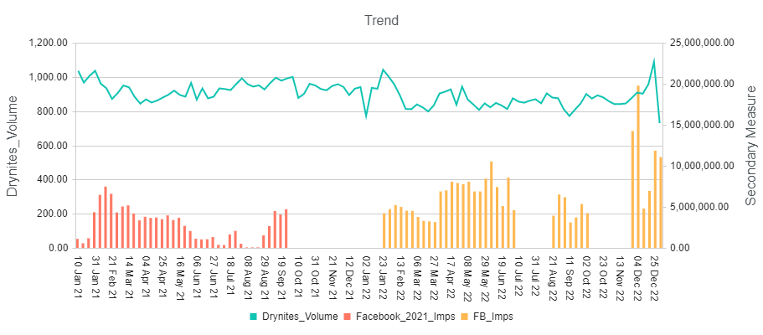
Facebook Imps vs DryNites Volume
Facebook execution has increased significantly in the year 2021
IMPs
Platform | Impressions |  | Spend GBP |  | CPM
 | 2021 | 2022 | 2021 | 2022 | 2021 | 2022
Facebook | 105,201,647 | 245,319,745 | 218,867 | 658,751 | 2,080 | 2,685
+133%
+201%
+29%
CPM : Cost/MM IMPs
Powered by Analytic Edge

Slide 5
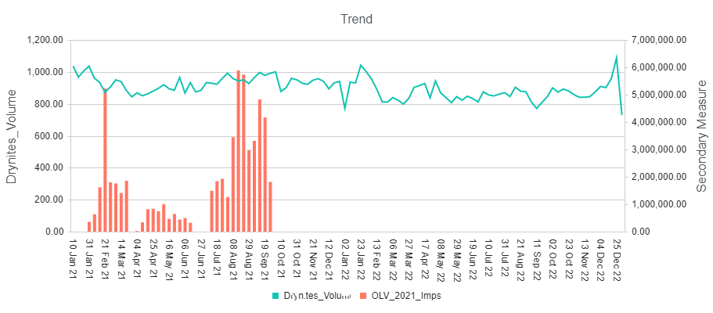
OLV Imps vs DryNites Volume
OLV has executed only during 2021
IMPs
Platform | Impressions |  | Spend GBP |  | CPM
 | 2021 | 2022 | 2021 | 2022 | 2021 | 2022
OLV | 59,011,835 | - | 174,723 | - | 2,961 | -
CPM : Cost/MM IMPs
Powered by Analytic Edge

Slide 6
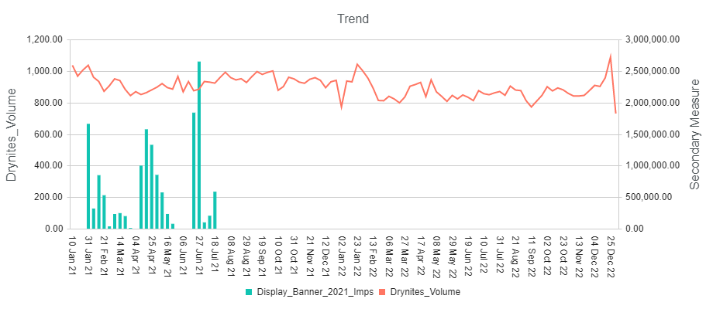
Display Banner Imps vs DryNites Volume
Display, has executed only during 2021 period
IMPs
Platform | Impressions |  | Spend GBP |  | CPM
 | 2021 | 2022 | 2021 | 2022 | 2021 | 2022
Display Banner | 14,970,735 | - | 47,074 | - | 3,144 | -
CPM : Cost/MM IMPs
Powered by Analytic Edge

Slide 7
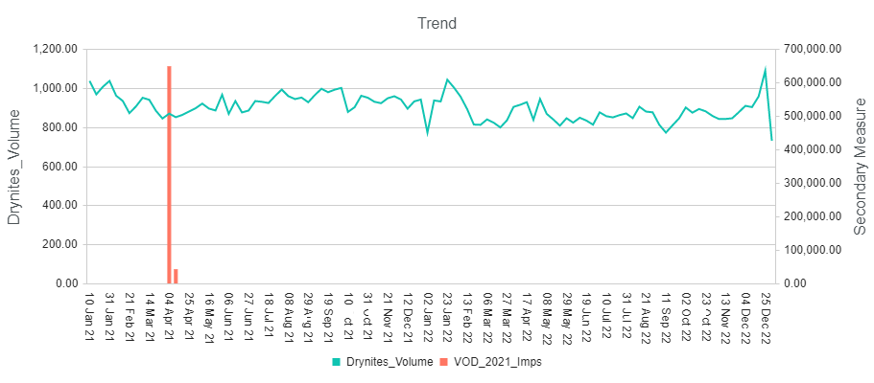
VOD Imps vs DryNites Volume
VOD, was executed only during April 2021 period
IMPs
Platform | Impressions |  | Spend GBP |  | CPM
 | 2021 | 2022 | 2021 | 2022 | 2021 | 2022
VOD | 687,248 | - | 20,617 | - | 30,000 | -
CPM : Cost/MM IMPs
Powered by Analytic Edge

Slide 8
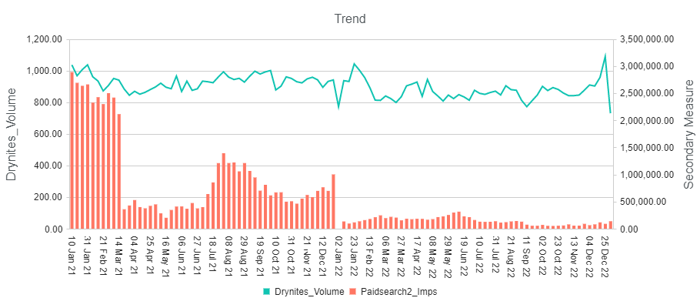
Paid Search Imps vs DryNites Volume
The CPM of Paid-search has increased significantly.
IMPs
Platform | Impressions |  | Spend GBP |  | CPM
 | 2021 | 2022 | 2021 | 2022 | 2021 | 2022
Paid Search | 51,442,121 | 7,024,000 | 125,094 | 99,722 | 2,432 | 14,197
-86%
-20%
+484%
CPM : Cost/MM IMPs
Powered by Analytic Edge

Slide 9
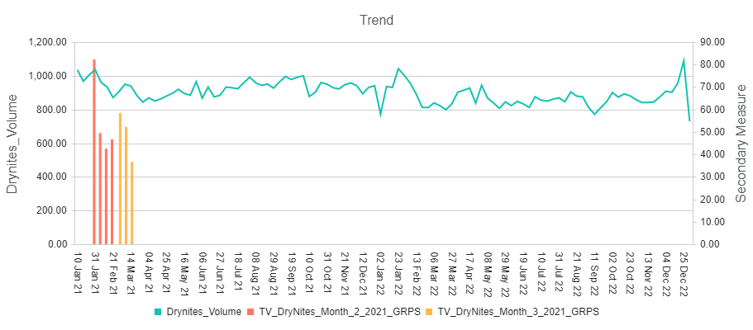
TV GRPs vs DryNites Volume
TV was executed only during H1 2021
GRPs
Platform | GRPs |  | Spend GBP |  | CPP
 | 2021 | 2022 | 2021 | 2022 | 2021 | 2022
TV | 367 | - | 424,574 | - | 1,158 | -
Powered by Analytic Edge

Slide 10
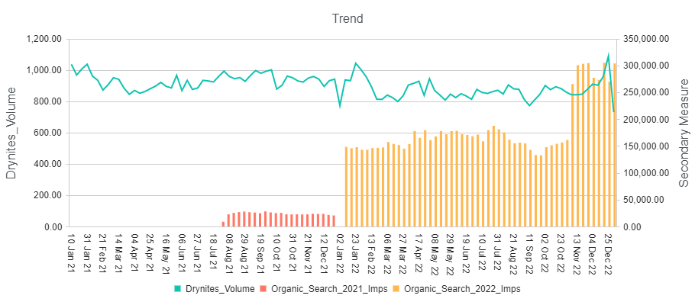
Organic Search Imps vs DryNites Volume
Organic Search, was executed during H2 2021 and FY 2022
IMPs
Platform | Impressions |  | Spend GBP |  | CPM
 | 2021 | 2022 | 2021 | 2022 | 2021 | 2022
Organic Search | 500,180 | 9,41,0507 | - | - | - | -
++
CPM : Cost/MM IMPs
Powered by Analytic Edge

Slide 11
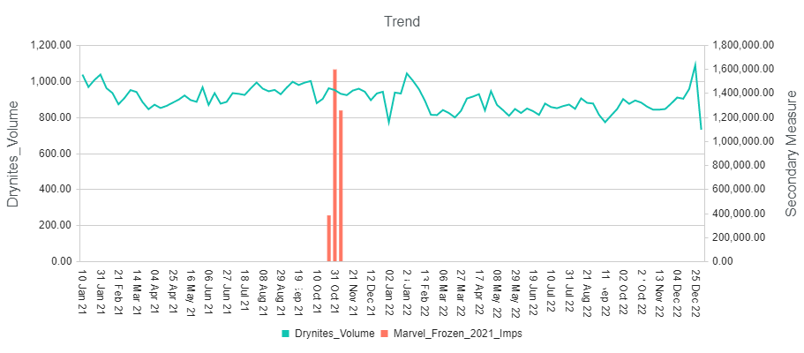
Marvel Frozen Imps vs DryNites Volume
For Marvel Frozen, there has been no spend in 2022
IMPs
Platform | Impressions |  | Spend GBP |  | CPM
 | 2021 | 2022 | 2021 | 2022 | 2021 | 2022
Marvel Frozen | 3,220,958 | - | - | - | - | -
CPM : Cost/MM IMPs
Powered by Analytic Edge

Slide 12
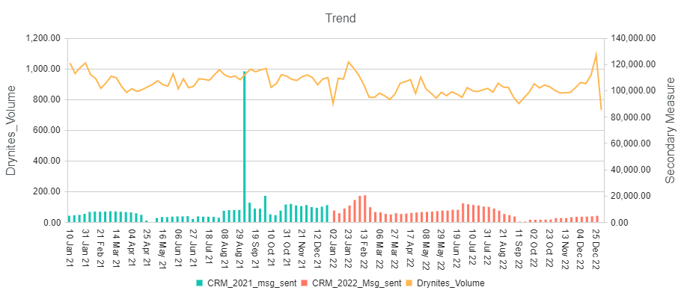
CRM Messages Sent vs DryNites Volume
CRM Messages sent were declined by 22% in 2022
Msgs
Platform | Message sent |  | Spend GBP |  | CPM
 | 2021 | 2022 | 2021 | 2022 | 2021 | 2022
CRM Email Msg Sent | 475,037 | 371,651 | - | - | - | -
-22%
Powered by Analytic Edge

Slide 13
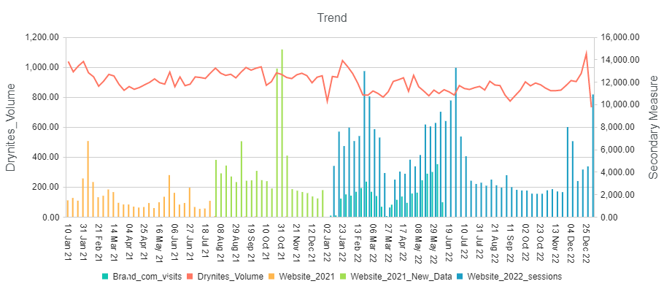
Brand/Website Visits vs DryNites Volume
Brand visitors and Website sessions are overlapping from Jan to May 2022
Visits/Sessions 2022
Platform | Visits 2021/Sessions 2022 |  | Spend GBP |  | CPM
 | 2021 | 2022 | 2021 | 2022 | 2021 | 2022
Brand Visit | - | 44,758 | - | - | - | -
Website New (Huggies) | 93,992 | - | - | - | - | -
Website(Drynites) | 50,631 | 273,311 | - | - | - | -
+440%
Powered by Analytic Edge

Slide 14
Powered by Analytic Edge

